Slide 1
CCC-OC Business and Entrepreneurship
Workforce development
Employability
Academic preparation
Community building
DR. CATHLEEN GREINER|REGIONAL DIRECTOR
BUSINESS AND ENTREPRENEURSHIP
ORANGE COUNTY
OCTOBER 2019

Slide 2
Getting to Know Your Regional Director of Employer Engagement (RDEE)
Cathleen Greiner, PhD
Regional Director of Employer Engagement
Business & Entrepreneurship

Slide 4
OC’s Priority Sectors (of 10 in CA):
Agriculture, Water & Environmental Technologies
Advanced Manufacturing
Advanced Transportation & Logistics
Business & Entrepreneurship
Global Trade
Energy, Construction, & Utilities
Health
Information & Communication Technologies (ICT)/Digital Media
Retail, Hospitality, Tourism
Life Sciences/Biotech

Slide 5
Serve as the connection
between industry, community colleges, and entrepreneurial resources
to prepare residents for living wage positions and careers
to create a stronger workforce
in each region and priority sector.
What is a
Regional Director of Employer Engagement?

Slide 6
Regional Director of Employer Engagement
Works with region’s schools, colleges, employers: alignment, career pathways, workforce training
Helps Entrepreneurs launch/scale: SBDCs, funding sources, workshops, education, etc.
Provides Data: Utilize LMI and COE, obtain/share critical careers/skills information

Slide 7
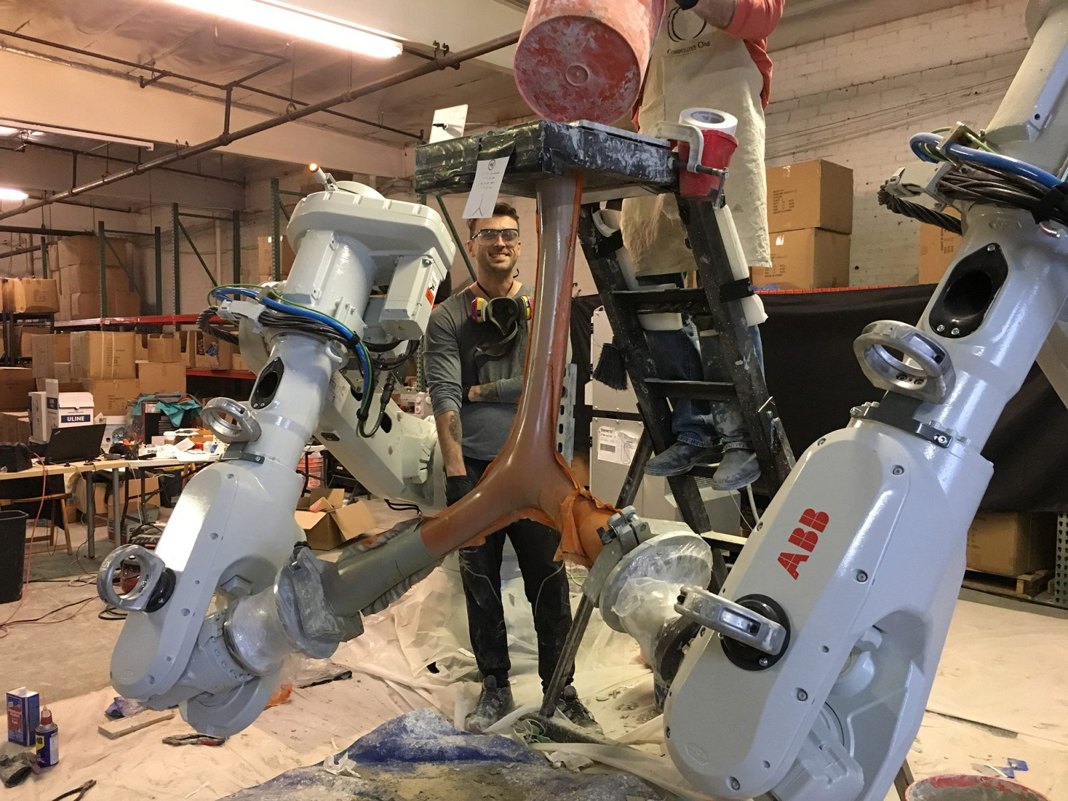
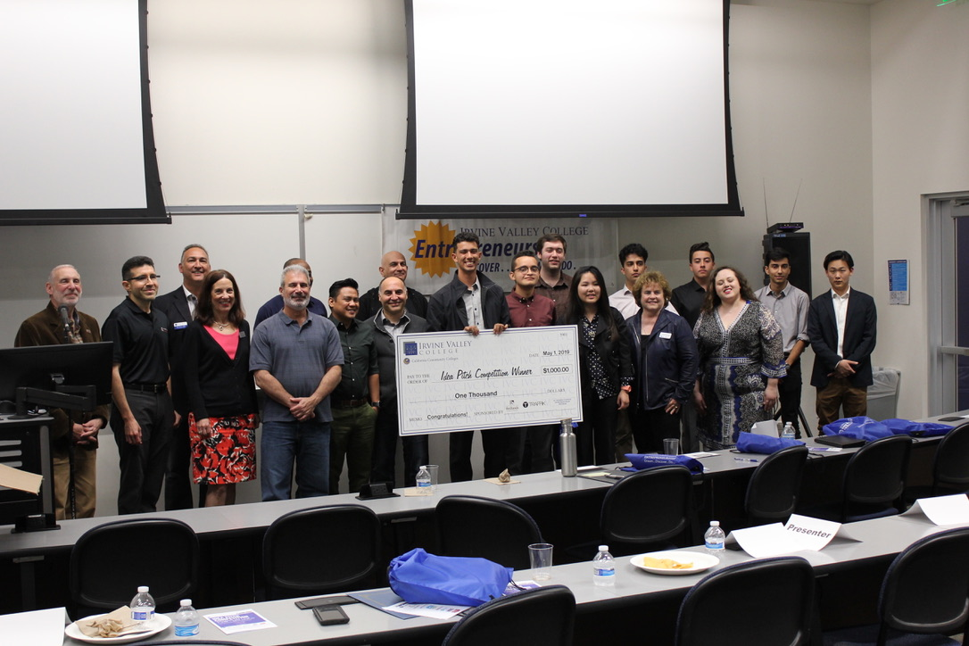
Opportunities & Participation

Slide 8
OC-At-A-Glance...
1st in medical device manufacturing
1st in transportation innovation and master planned communities
2nd largest workforce in California
3rd most diverse tech sector in U.S.
2.8% unemployment rate
5th most educated county in the U.S.
6th largest county by population in the U.S.
Innovation is seen as a “driving force of economic development” *

Slide 9
California is now the world's fifth-largest economy, surpassing United Kingdom
The data demonstrate the sheer immensity of California's economy
California's strong economic performance relative to other industrialized economies is driven by worker productivity*
California's gross domestic product rose by $127 billion from 2016 to 2017, surpassing $2.7 trillion. | California's economic output is now surpassed only by the total GDP of the United States, China, Japan and Germany.
5 | 1,2,3,4
* 40M people | UK 65M people

Slide 10
BUS + ENT OC
College | Business | Entrepreneurship
Santa Ana | X | X
Santiago | X | X
Saddleback | X | X
Irvine | X | X
Coastline | X | X
Golden West | X | X
Orange Coast | X | X
Fullerton | X | X
Cypress | X | X

Slide 11
Changing Dynamics in the Workplace and Workforce

Slide 12
YES..PRINTED OUT! At-A-Glance Table | Centers of Excellence, OC

Slide 13
Questions?

Slide 14
Thank You!
Cathleen Greiner, PhD
Regional Director of Employer Engagement
Business & Entrepreneurship Sector
Serving the Orange County Region
greiner_Cathleen@rsccd.edu
BUSINESS AND ENTREPRENERUSHIP
ORANGE COUNTY
CALIFORNIA COMMUNITY COLLEGES
WORKFORCE AND ECONOMIC DEVELOPMENT

